Slide 1
Noise functions

Slide 2
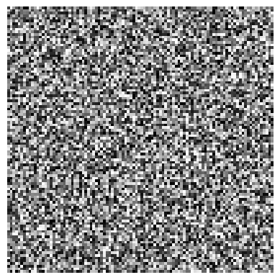
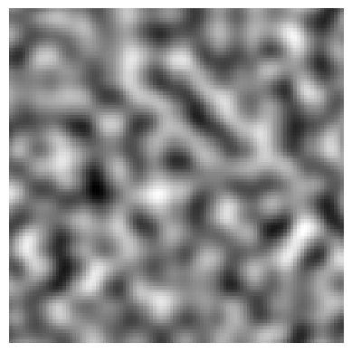
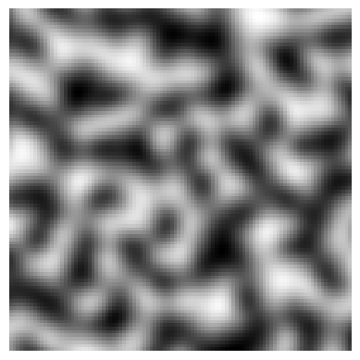
Noise functions
Functions which map 1D, 2D or 3D points to pseudorandom values
Input parameter is a float or Vector2 or Vector3; output return value is a float
Pure random noise is generally not used as it’s too noisy
Perlin noise has smoother gradients
Simplex noise (also developed by Perlin!) uses a non-rectangular grid – reduces artefacts

Slide 3
Fractal noise
Can get higher frequency noise by multiplying the x, y, z parameters by a constant
Can change the amplitude of noise by multiplying the output by a constant
Fractal noise: add together several frequencies of noise – higher frequency, lower amplitude
Low frequency features are big – mountains, valleys
High frequency features are small – bumpy surfaces

Slide 4



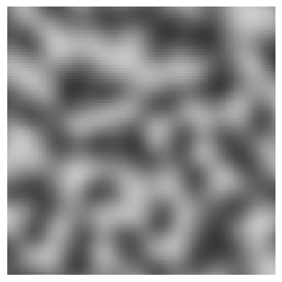
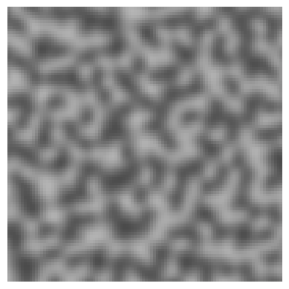
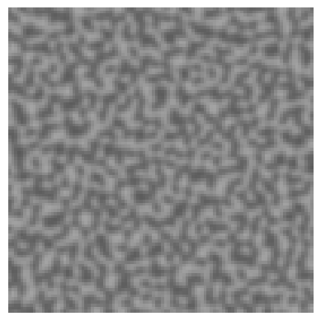

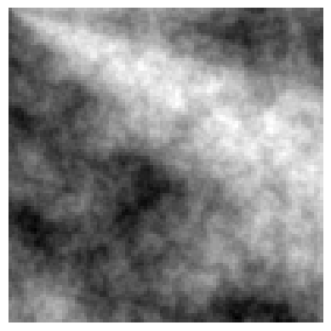
Fractal noise example
+
+
+
+
+
+
=

Slide 5


Slide 6
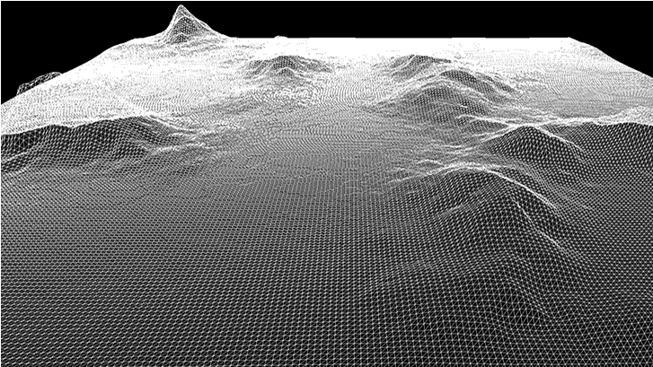
Using noise
2D noise can be used as a height map to generate terrain
Start with a 2D grid on the X-Z plane
Set the Y value of each vertex based on the noise value

Slide 7
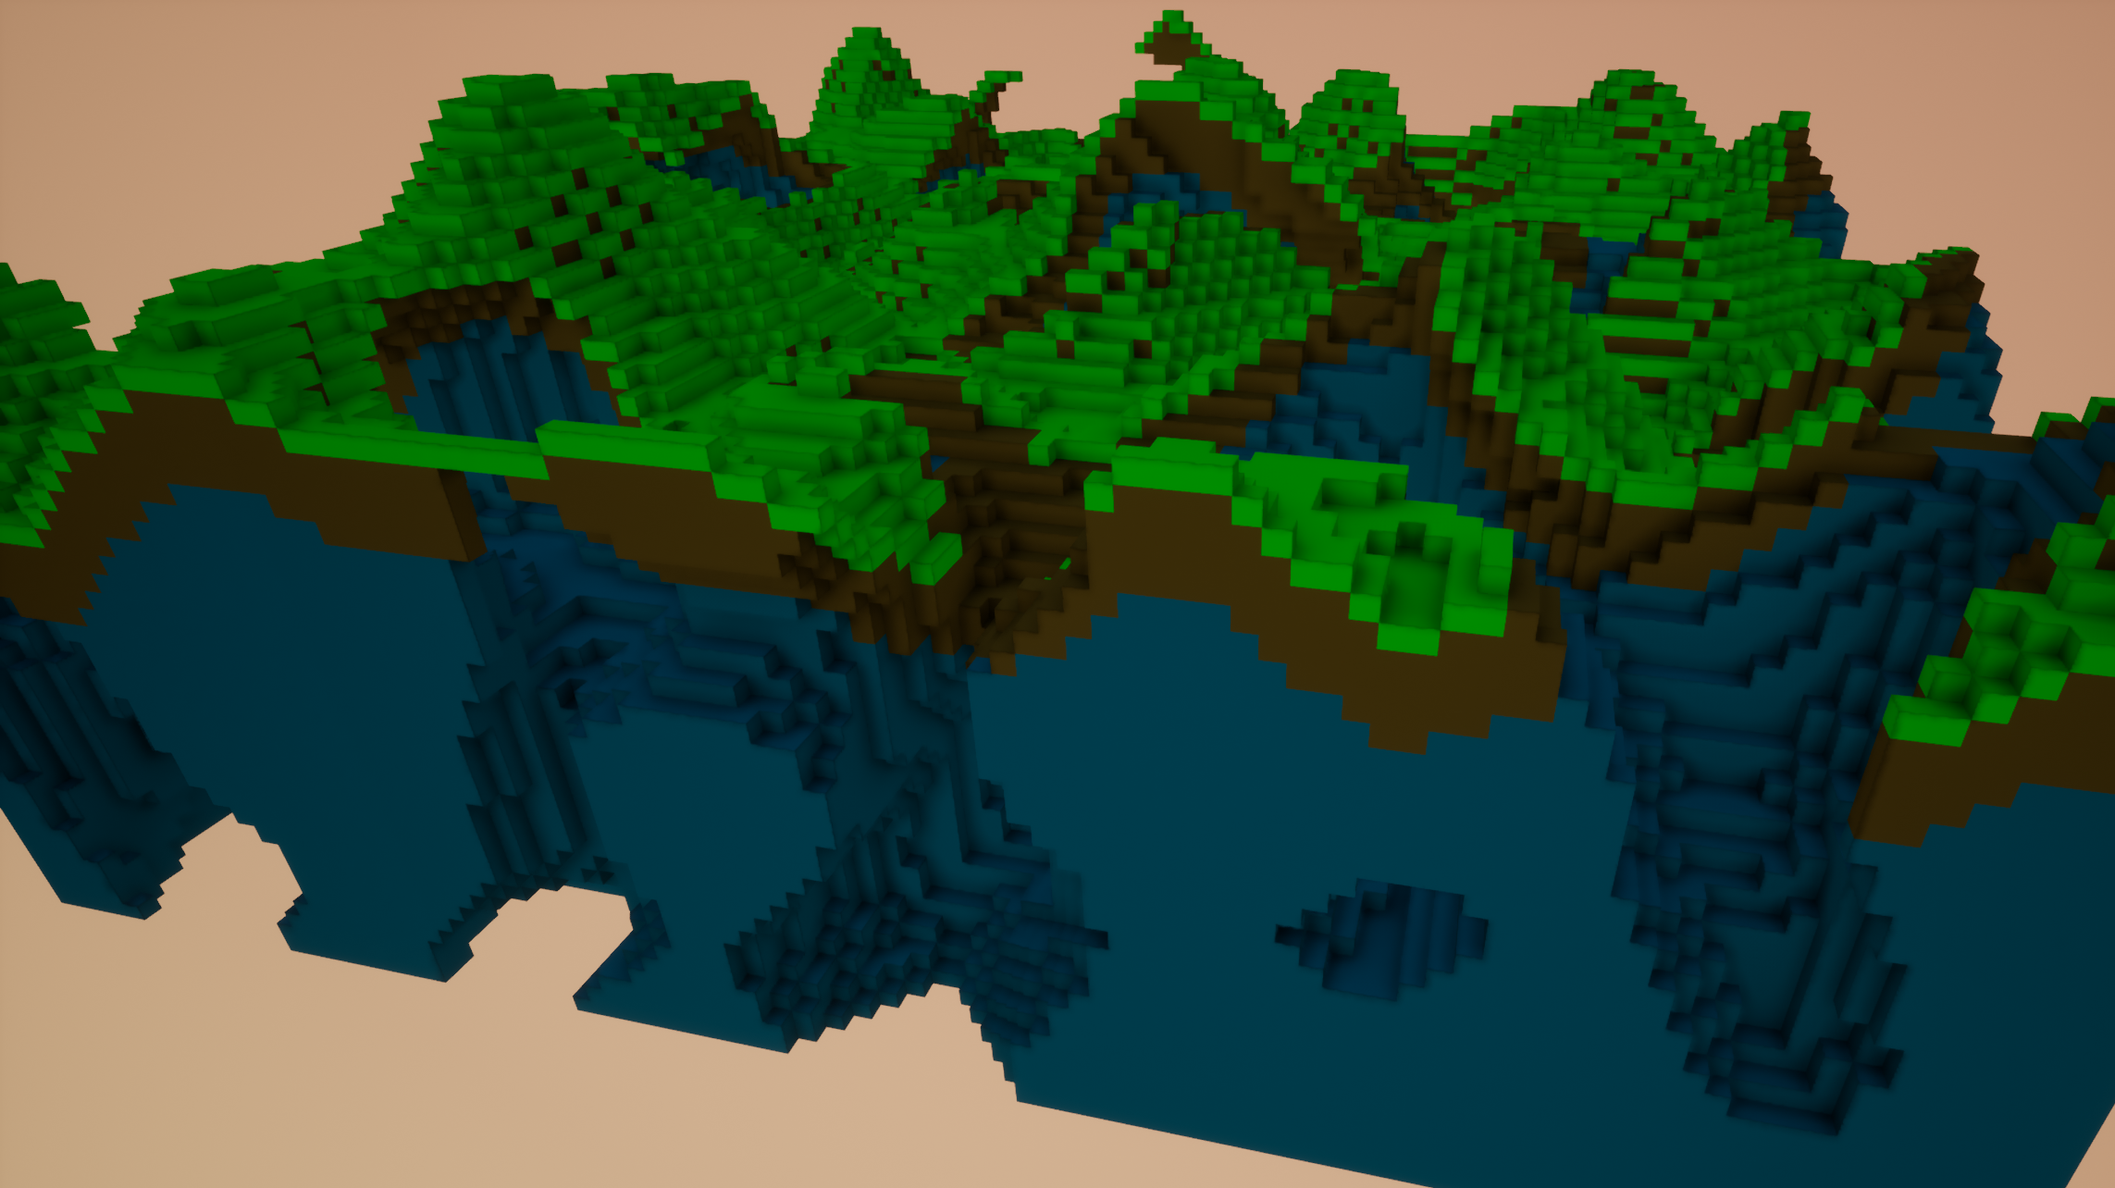
Using noise
Generate 3D noise on a voxel grid
Apply a threshold – e.g. if noise(x, y, z) > 0.5 then fill the voxel, else leave empty
Can generate “Minecraft-style” terrain with caves

Slide 8
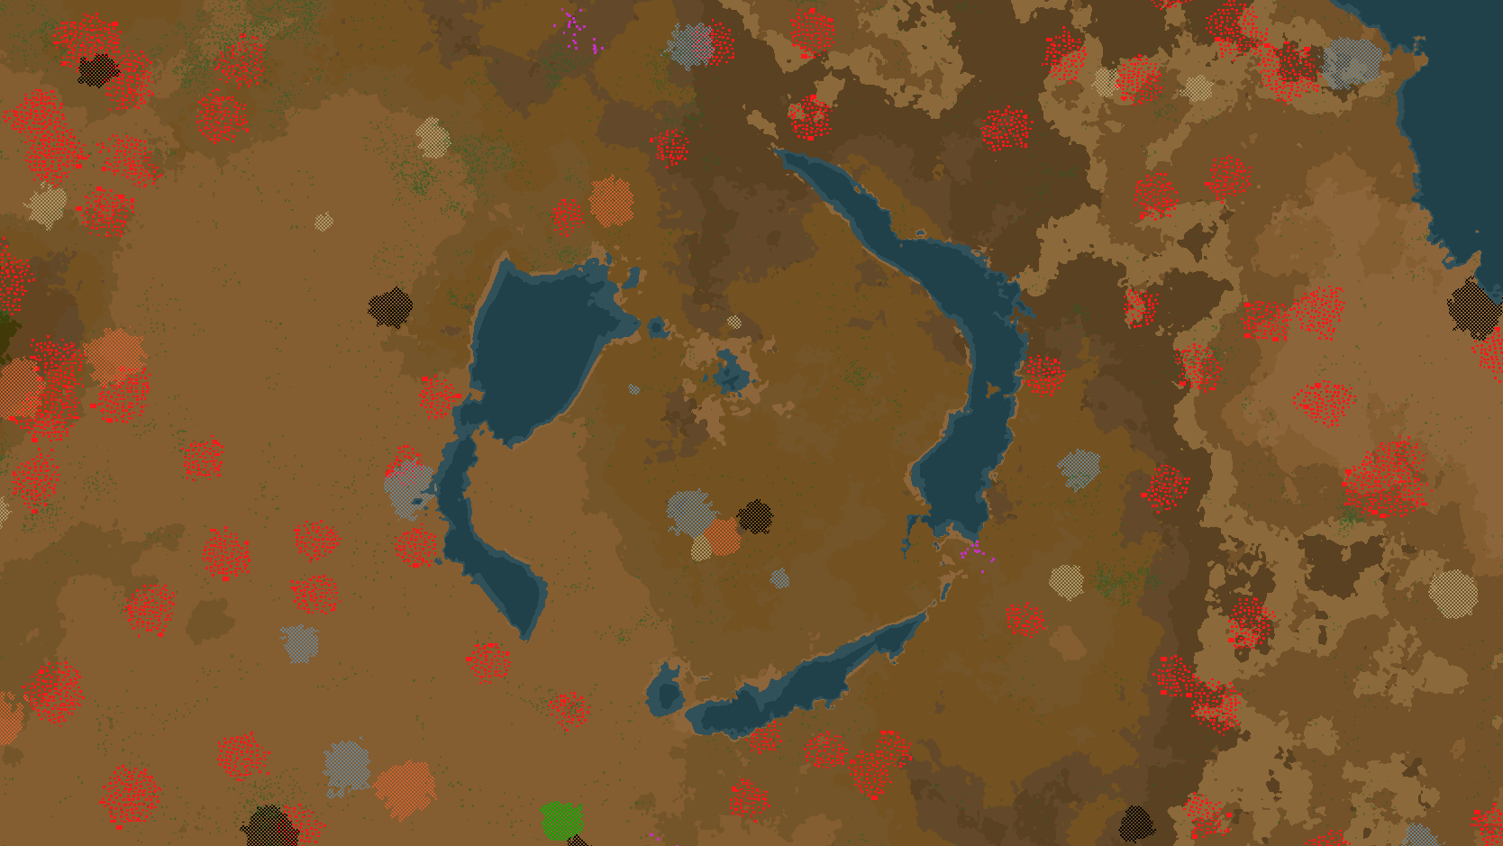
Using noise
Different noise functions can be layered to generate terrain, water, resources, …

Slide 9

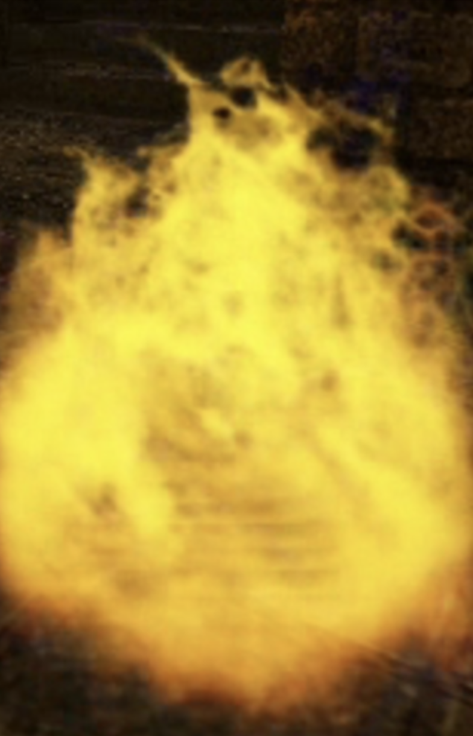

Using noise
Many creative uses of noise to generate textures
Clouds, water, fire, marble, wood, grass, lava, liquid, …

Slide 10
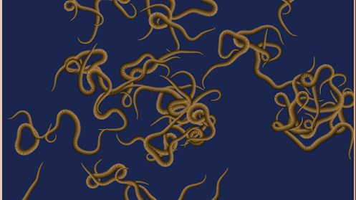
Using noise
Perlin worms
Use the noise function to guide a random walk
Can be used to generate caves, rivers, artificial life, …

Slide 11
N-gram models

Slide 12
N-grams
Consider a text string
An N-gram is a sequence of N consecutive characters
E.g. a 2-gram is a pair of characters, a 3-gram is a triple, etc
I | n | t | e | l | l | i | g | e | n | c | e
2-grams: “In”, “nt”, “te”, “el”, “ll”, “li”, …
3-grams: “Int”, “nte”, “tel”, “ell”, “lli”, …

Slide 13
Training a model
3-gram | Frequency
ton | 156
ham | 95
ing | 79
ort | 57
ord | 54
for | 53
ley | 51
ter | 49
on- | 41
rth | 40
est | 39
and | 39
sto | 38
Given a large set of text, we can count the frequency of each possible N-gram
This is a very basic form of machine learning

Slide 14
Using the model
3-gram | Frequency
out | 34
oug | 29
our | 9
ouc | 3
ous | 2
oul | 2
oud | 1
Generate a string iteratively
At each step, look at the last N-1 characters
Frequency table tells us how often each following letter occurs
Choose next letter at random based on these frequencies
S | o | u

Slide 15
English towns and cities, n=2
Kile
Daswichin
Dury
Selt Maney
Brerrntomonghone
Bichaxmbyke
Witllesl
Sts
Dan-Fon
Kinhyn
Wan
Soth
Eam
Oshicedbor
Farorsthemetondort Horthers
Cach
Nene
Cale
Telk
Pe

Slide 16
English towns and cities, n=3
Gray
Wiveyntinscomyaltongwarighton
Twickham
St Reth Edmandfieleigh
Toth Warle-one
Sandburntword
Amborley
Rowmand
Sough
Mitnabley
Southetford
Whipon
Dary
Ive
Wivey
Bunston Leothet Hareetton
Marthoe
Hykerthes
Easterloughord
Oakeat Ber

Slide 17
English towns and cities, n=6
Lichfield
Medlar with Newton
Fazeley
Frinton and Winslow
Penrith
Malmesbury
Crewkerne
Staines-upon-Thames
Blyth
Alston
Gainsborough
Falmouth
Burton and Loscoe
Oakengates
Reading
Wem
Burgh-le-Marsh
Morecambe
Torpoint
Chagford

Slide 18
RPG games, N=4
Under
City
Dunger
Thieveration
Rune
Commission
Fants of the Domin
Fifth Cycle Warrings Alley on Heroughtern
Dangers
Breathworld
Stal Freet Voyage of the 7 Skyrealms of the 23rd Weird RPG
Legave
Rapture Game
Cutthroat: The One Weird is - Time of And Creak: The SpaceTimemastic Role-Playing Game
Fantain
Fearscapes
Mekton's World
Omnighboronicle
Hard of Dark Dunger Suburban Earterning game
Dead

Slide 19
Pokemon, N=3
Shinett
Swagon
Shera
Surk
Miepting
Munid
Raile
Gulayque
Learodur
Whirizior
Fareezormado
Forusharon
Sawsbulbastarcato
Close
Trespra
Woobbuzz
Swakar
Para
Woonfoom
Phime Jr.

Slide 20
“The adventures of sherlock holmes”, n=3
“We sons, at ve do way mising,” he tonfeent unithathe ingave whove; I haver at sectes. We to buiether a vould gothe ingust andearematin as larchat a sad I hich so I ingic se-bas wance theiresse thipsell and hat I cout ince.

Slide 21
“The adventures of sherlock holmes”, n=10
“You are a benefactor. Are you hungry, Watson, founded upon the table and glanced back at me.” The words of the sill, but I felt a sudden effort, straight into the match, and lashed furiously with his thick red finger planted halfway down Swandam Lane is a vile alley lurking behind us, and send down to the fire. The last straggling houses here. It arrived. I paid the fee was at least a presumption that Colonel Lysander Stark stopped at last.

Slide 22
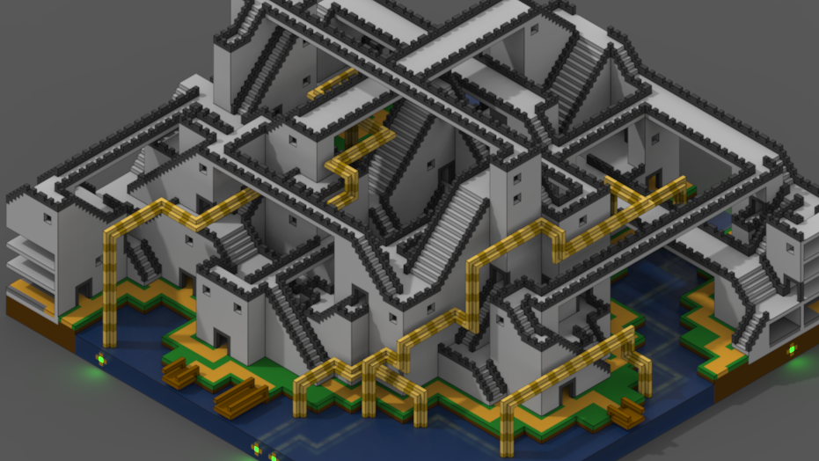
Other uses
Not limited to generating text – can generate other sequences e.g. music, game levels
Related technique in 2D/3D: Wave Function Collapse (WFC)

